Slide 1
APPENDIX
Cost & Weight Analysis Approach Described
  Inputs and Process
  Distribution of Costs
  Definitions & Assumptions
  Example Cost Breakdown
Manufacturing Cost Details
  Dodge Ram Extended Cab
    MY 2007 & MY 2010
  Ford Edge
    MY 2009 & MY 2016
  Honda Accord
    MY 2010 & MY 2014
  Ford Mustang
    MY 2006 & MY 2016
  Jeep Grand Cherokee
    MY 2008 & MY 2011
  Buick LaCrosse
    MY 2005 & MY 2010
  Chevrolet Impala
    MY 2003 & MY 2011

Slide 2
Cost Methodology and Assumptions
Cost Analysis Inputs and Process
Production Volumes
BOM Boundaries
Country of Manufacture
Calculate Total
Manufacturing
Cost
Set Project Parameters
Surface Mount
Through Hole
Cycle Time
Single-Sided
Double-Sided
Process Equipment
Research Processing Data
Calculate Manufacturing
Scrap
Component Specifications
Materials Used
Process Flow
Process Type
Test Requirements
Obtain and Teardown Service Parts to Record
Parametric Data
Country of Mfg
Labor Rates: Direct & Indirect
Number of Heads
Utility Rates/Insurance
Taxes/Burden
Calculate
SG&A + Profit
Research Financial Data
Calculate 2017CY
Manufacturing Based
Selling Price to OEM
Calculate Cost of
Materials
Purchased
Apply Retail Price
Equivalent (RPE) factor
to get end-user costs
Component Package
Component Volume
Component Function
Layer Count
Research Other Component Characteristics
Calculate Cost of
Inbound Freight
Complete

Slide 3
Cost Methodology and Assumptions
Distribution of Costs
Fixed Costs | Capital Equipment Amortization Capital Equipment Installation Amortization Interest Floor Space Including Manufacturing Area and Offices Taxes - Local and Property Insurance - Personal Property and Liability
Variable Costs | Indirect Plant Staff Material Handlers 1st Line Supervisors Tool Maintenance Facility Maintenance Non Production Plant Supplies Energy - Electricity, Natural Gas, Water, Compressed Air In Process Scrap Process Gasses (Nitrogen, Argon, etc) Fringe on Direct
SG&A Costs | Top Plant Management Supplier Quality HR Related Divisional / HQ Cost Research and Development Sales
Profit
Materials
Direct Labor

Slide 4
Cost Methodology and Assumptions
Definitions and Assumptions (1 of 2)
Annual Vehicle Production Volume | 200,000 units per year
Manufacturing Cost | Costs of Materials + Labor + Piece Burden Cost (USA)
SG&A | 7% of Total Manufacturing Cost (Based on Automotive Industry)
Pre Tax Profit | 4% of Total Manufacturing Cost (Based on Automotive Industry)
Freight Cost (Inbound to Vendor) | 3% of Purchased Materials Cost (Based on Automotive Industry)
Supplier costs not Included | OEM ED&D Outbound (to OEM) Packaging & Transportation Tooling Taxes -Tariffs Royalty-License Fees Software development and integration costs

Slide 5
Cost Methodology and Assumptions
Definitions and Assumptions (2 of 2)
Mechanical Components | Assembly & Mfg. Location | United States
 | Equipment Amortization | 5 Years Straight Line, $0 Residual Value
 | Operation Plan | 1- 8 Hour Shift/200K
 | Burdened Labor Rate | $32.81/hr (United States Machining/Assembly); $23.20 (United States Injection Molding)
 | Indirect Labor Rate | 45% - 50% (Depending on Complexity)
 | Scrap | 1% Total Materials Cost (Based on Automotive Industry)

Slide 6
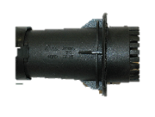




Example Cost Breakdown
Each subassembly is analyzed down to component level
Example: Fuel Filler Neck Valve Assembly
Subcomponents
Cycle (sec) | Number Out | Man Power | Direct Labor | Fixed | Variable | Material | Sub Cost | SG&A | Profit | Freight | $/Unit | $/System
Housing
18.28 | 4 | 0.25 | $0.01 | $0.04 | $0.02 | $0.06 | $0.12 | $0.01 | $0.01 | $0.00 | $0.14 | $0.14
- | - | - | $0.00 | $0.00 | $0.00 | $0.03 | $0.03 | $0.00 | $0.00 | $0.00 | $0.04 | $0.04
17.6 | 8 | 0.25 | $0.00 | $0.01 | $0.01 | $0.01 | $0.04 | $0.00 | $0.00 | $0.00 | $0.04 | $0.04
14.8 | 8 | 0.25 | $0.00 | $0.01 | $0.01 | $0.01 | $0.03 | $0.00 | $0.00 | $0.00 | $0.04 | $0.04
- | - | - | $0.00 | $0.00 | $0.00 | $0.02 | $0.02 | $0.00 | $0.00 | $0.00 | $0.02 | $0.02
- | - | - | $0.00 | $0.00 | $0.00 | $0.01 | $0.01 | $0.00 | $0.00 | $0.00 | $0.01 | $0.01
15.5 | 1 | 0.5 | $0.05 | $0.15 | $0.12 | $0.00 | $0.32 | $0.03 | $0.02 | $0.00 | $0.36 | $0.36
O-ring
Support
Gate
Spring
Pin
Assemble

Slide 7
Manufacture Cost Details
  Dodge Ram Extended Cab
    MY 2007 & MY 2010
  Ford Edge
    MY 2009 & MY 2016
  Honda Accord
    MY 2010 & MY 2014
  Ford Mustang
    MY 2006 & MY 2016
  Jeep Grand Cherokee
    MY 2008 & MY 2011
  Buick LaCrosse
    MY 2005 & MY 2010
  Chevrolet Impala
    MY 2003 & MY 2011

Slide 8
Ram Extended Cab, MY 2007
Detail manufacturing costs

Slide 9
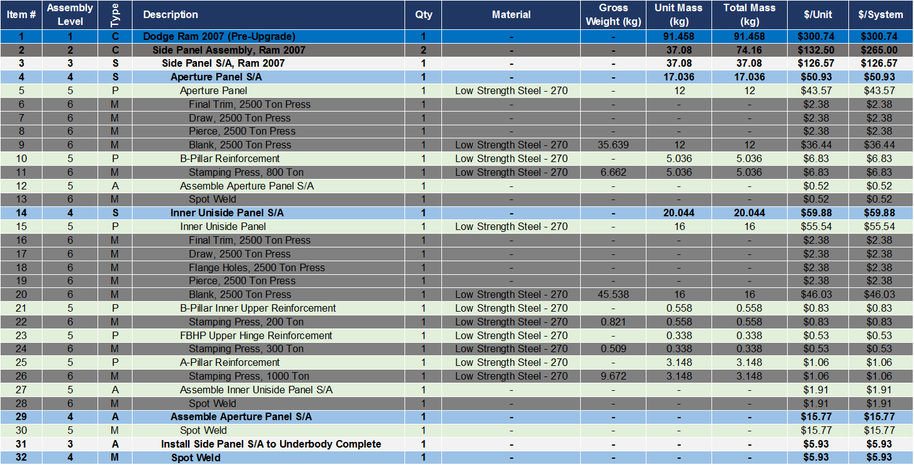
Ram Extended Cab 2007 Total Mass and Cost Details –
Side Panel Assembly
Material Details Ram Extended Cab, 2007
Type: S=Subassembly, P=Part, M=Manufacturing Process, A=Assemble, C=Container

Slide 10
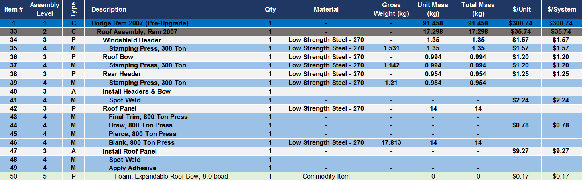
Ram Extended Cab 2007 Total Mass and Cost Details –
Roof Assembly
Material Details Ram Extended Cab, 2007
Type: S=Subassembly, P=Part, M=Manufacturing Process, A=Assemble, C=Container

Slide 11
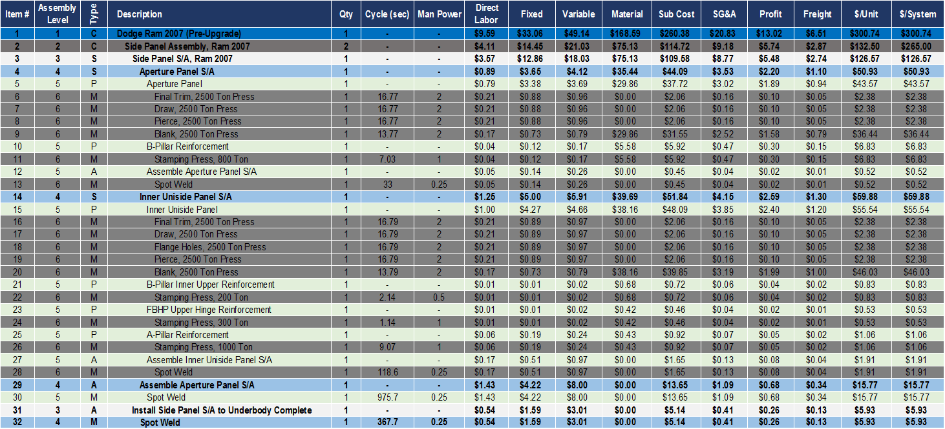
Ram Extended Cab 2007 Manufacturing Cost Details –
Side Panel Assembly
Cost Details Ram Extended Cab, 2007
Type: S=Subassembly, P=Part, M=Manufacturing Process, A=Assemble, C=Container

Slide 12
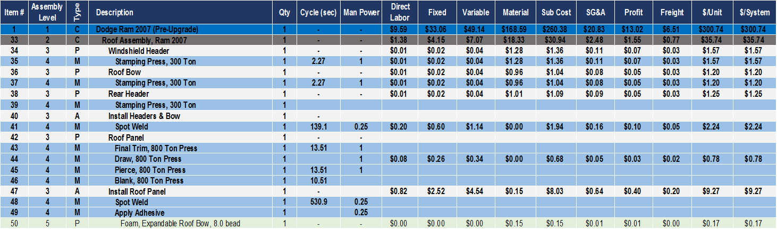
Ram Extended Cab 2007 Manufacturing Cost Details –
Roof Assembly
Cost Details Ram Extended Cab, 2007
Type: S=Subassembly, P=Part, M=Manufacturing Process, A=Assemble, C=Container

Slide 13
Ram Extended Cab, MY 2010
Detail manufacturing costs

Slide 14
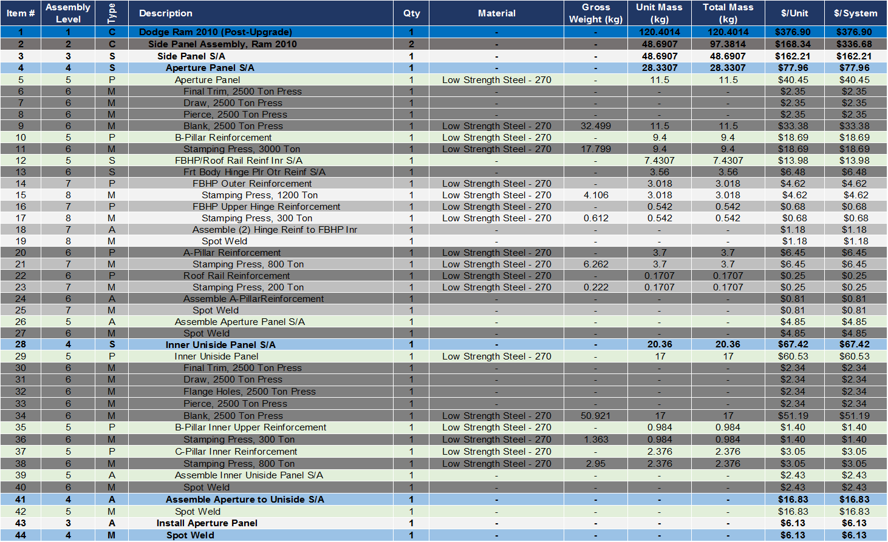
Ram Extended Cab 2010 Total Mass and Cost Details –
Side Panel Assembly
Material Details Ram Extended Cab, 2010
Type: S=Subassembly, P=Part, M=Manufacturing Process, A=Assemble, C=Container

Slide 15
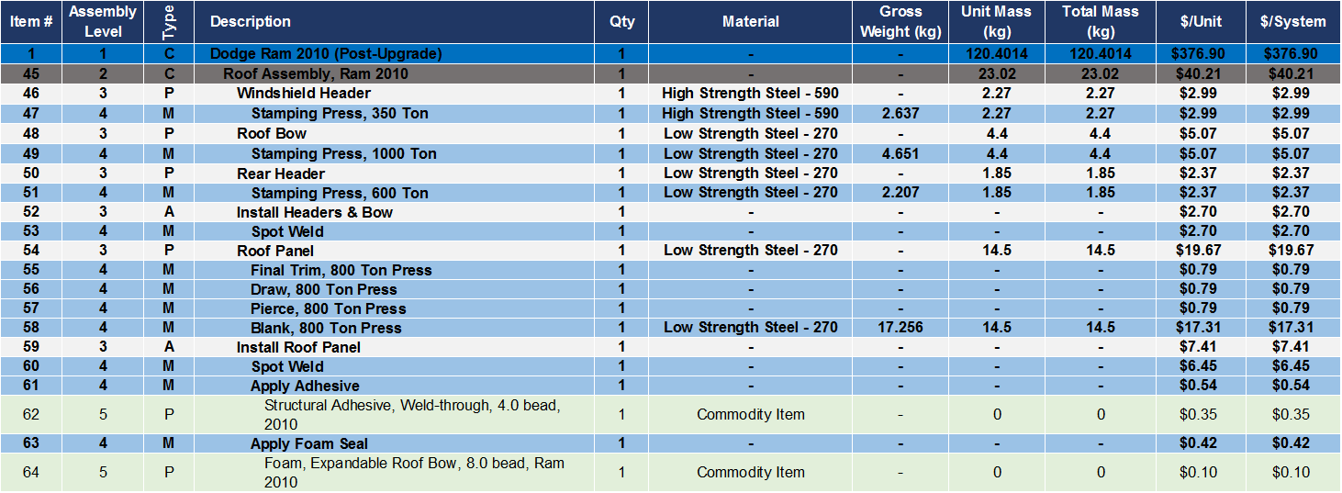
Ram Extended Cab 2010 Total Mass and Cost Details –
Roof Assembly
Material Details Ram Extended Cab, 2010
Type: S=Subassembly, P=Part, M=Manufacturing Process, A=Assemble, C=Container

Slide 16
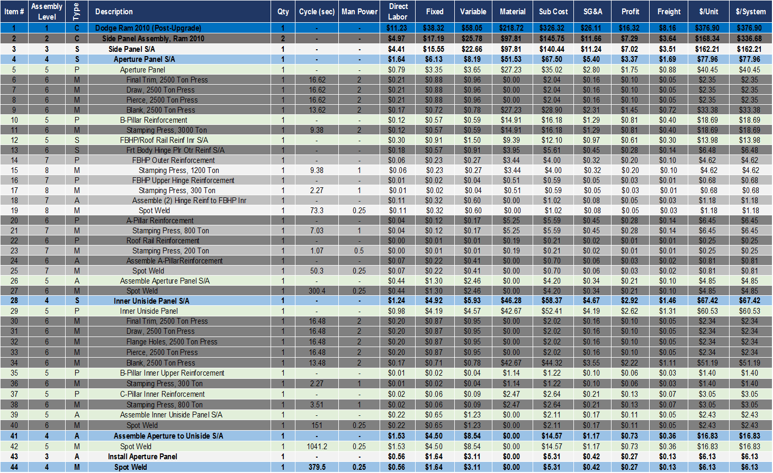
Ram Extended Cab 2010 Manufacturing Cost Details –
Side Panel Assembly
Cost Details Ram Extended Cab, 2010
Type: S=Subassembly, P=Part, M=Manufacturing Process, A=Assemble, C=Container

Slide 17
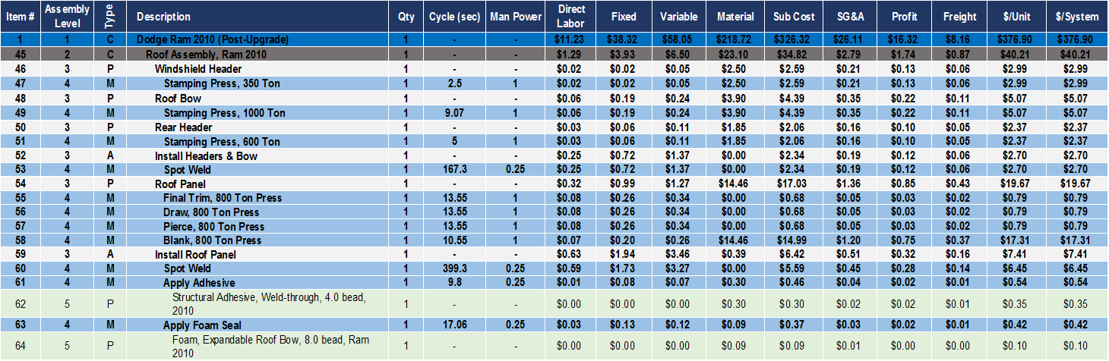
Ram Extended Cab 2010 Manufacturing Cost Details –
Roof Assembly
Cost Details Ram Extended Cab, 2010
Type: S=Subassembly, P=Part, M=Manufacturing Process, A=Assemble, C=Container

Slide 18
Ford Edge, MY 2009
Detail manufacturing costs

Slide 19
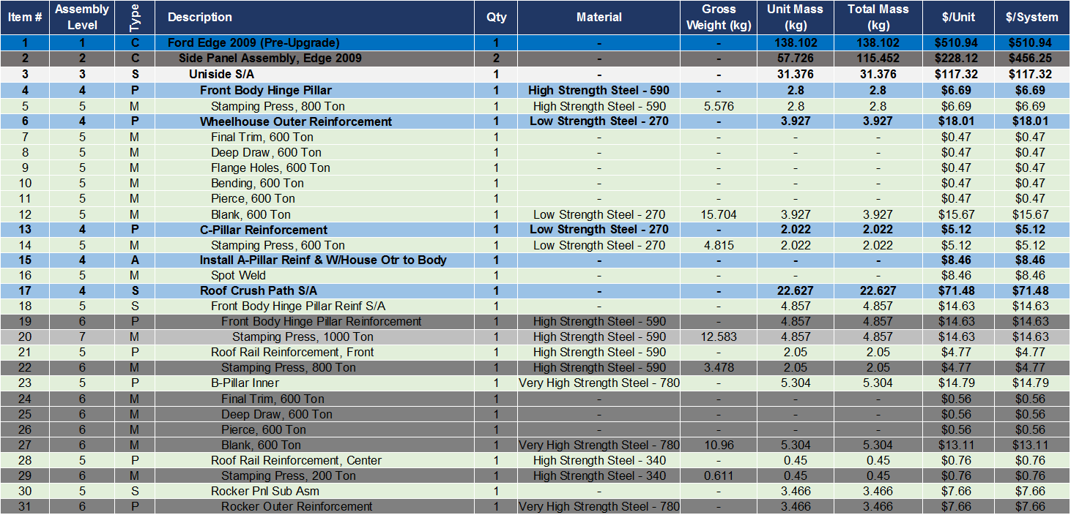
Ford Edge 2009 2014 Total Mass and Cost Details –
Side Panel Assembly (1/2)
Material Details Ford Edge, 2009
Type: S=Subassembly, P=Part, M=Manufacturing Process, A=Assemble, C=Container

Slide 20
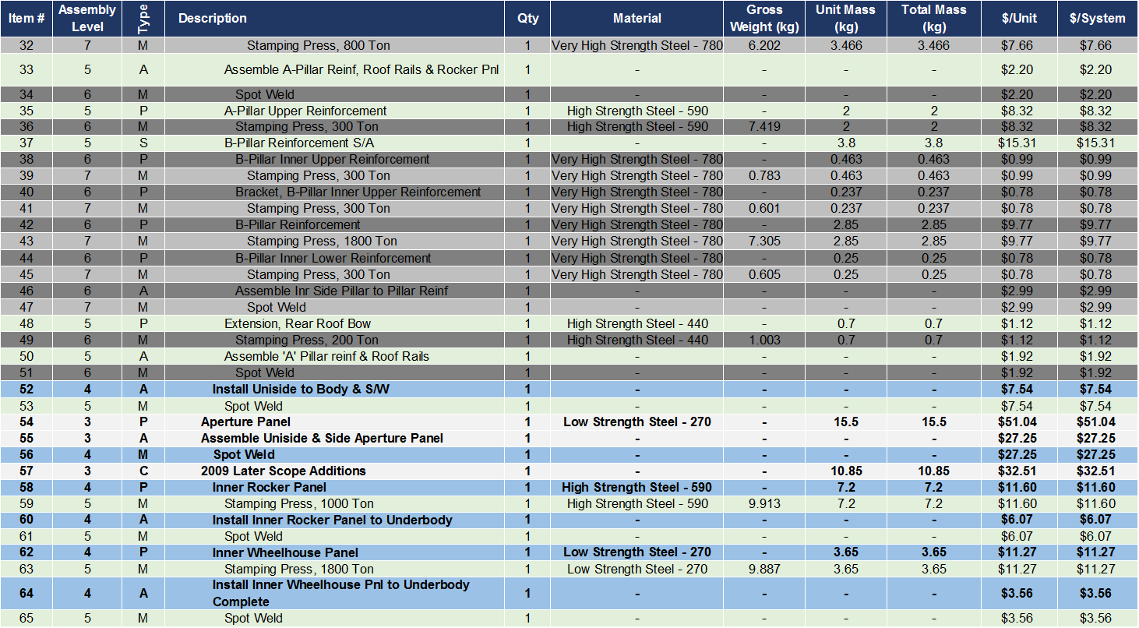
Ford Edge 2009 Total Mass and Cost Details –
Side Panel Assembly (2/2)
Material Details Ford Edge, 2009
Type: S=Subassembly, P=Part, M=Manufacturing Process, A=Assemble, C=Container

Slide 21
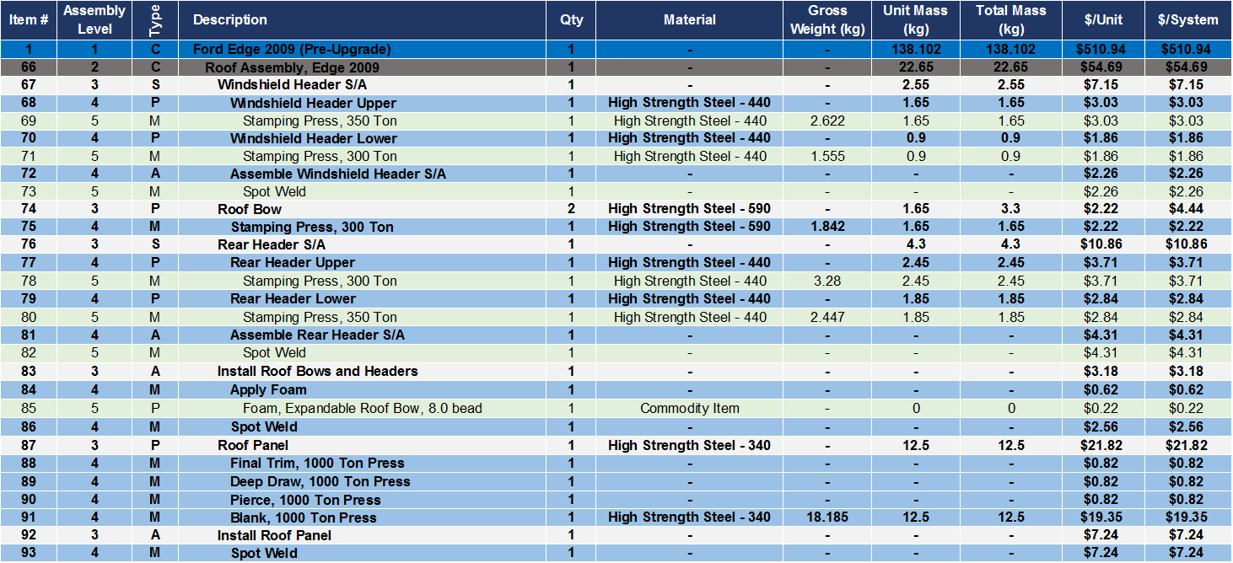
Ford Edge 2009 Total Mass and Cost Details –
Roof Assembly
Material Details Ford Edge, 2009
Type: S=Subassembly, P=Part, M=Manufacturing Process, A=Assemble, C=Container

Slide 22
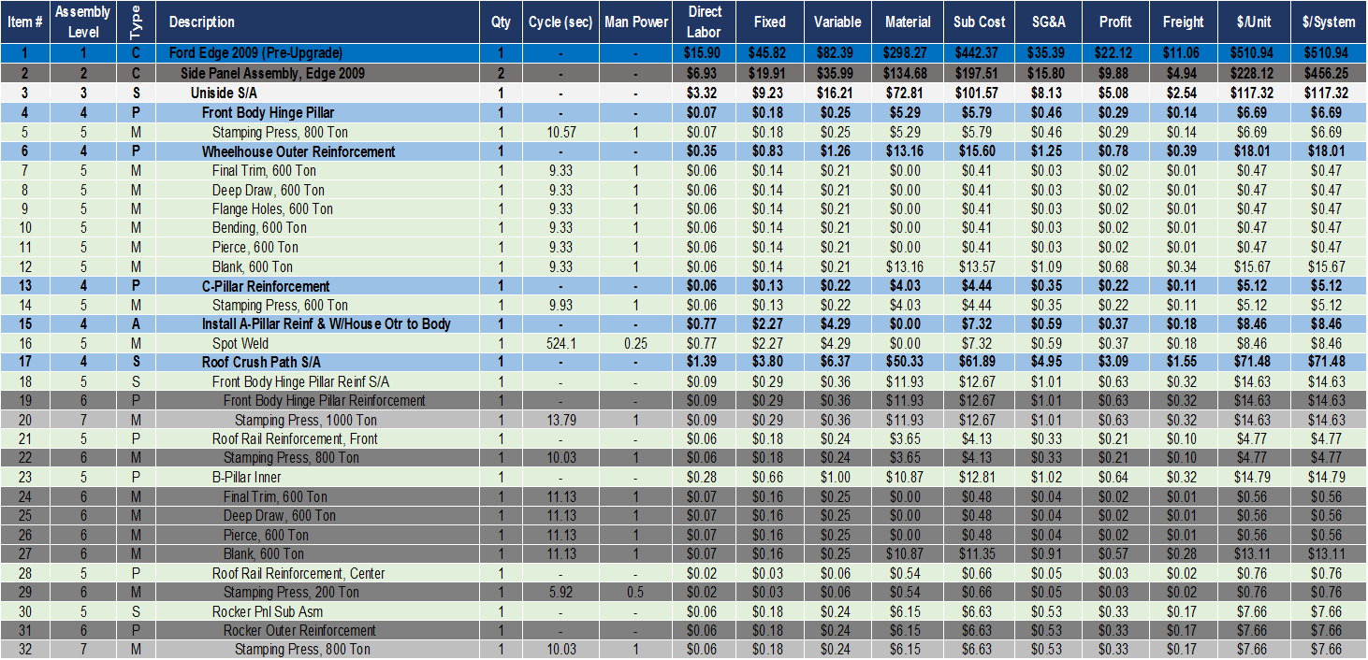
Ford Edge 2009 Manufacturing Cost Details –
Side Panel Assembly (1/2)
Cost Details Ford Edge, 2009
Type: S=Subassembly, P=Part, M=Manufacturing Process, A=Assemble, C=Container

Slide 23
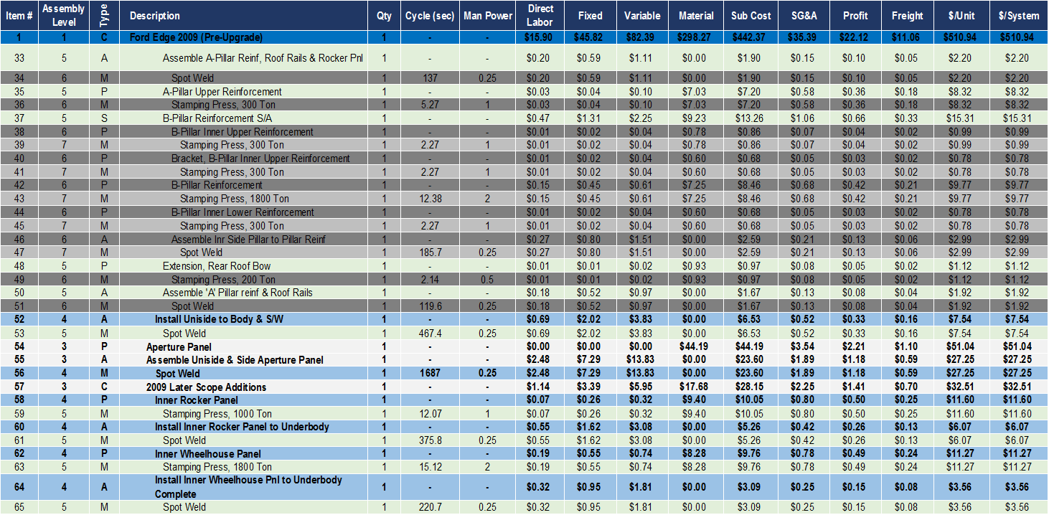
Ford Edge 2009 Manufacturing Cost Details –
Side Panel Assembly (2/2)
Cost Details Ford Edge, 2009
Type: S=Subassembly, P=Part, M=Manufacturing Process, A=Assemble, C=Container

Slide 24
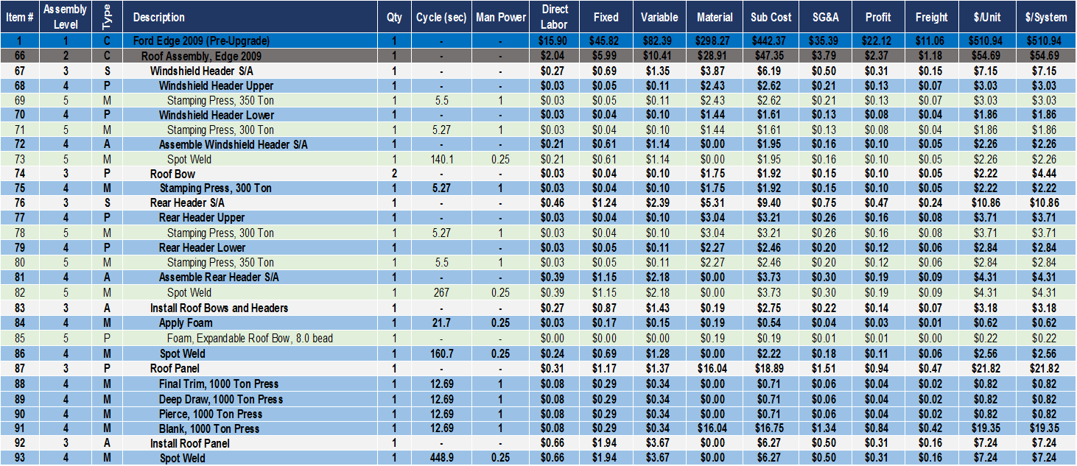
Ford Edge 2009 Manufacturing Cost Details –
Roof Assembly
Cost Details Ford Edge, 2009
Type: S=Subassembly, P=Part, M=Manufacturing Process, A=Assemble, C=Container

Slide 25
Ford Edge, MY 2016
Detail manufacturing costs

Slide 26
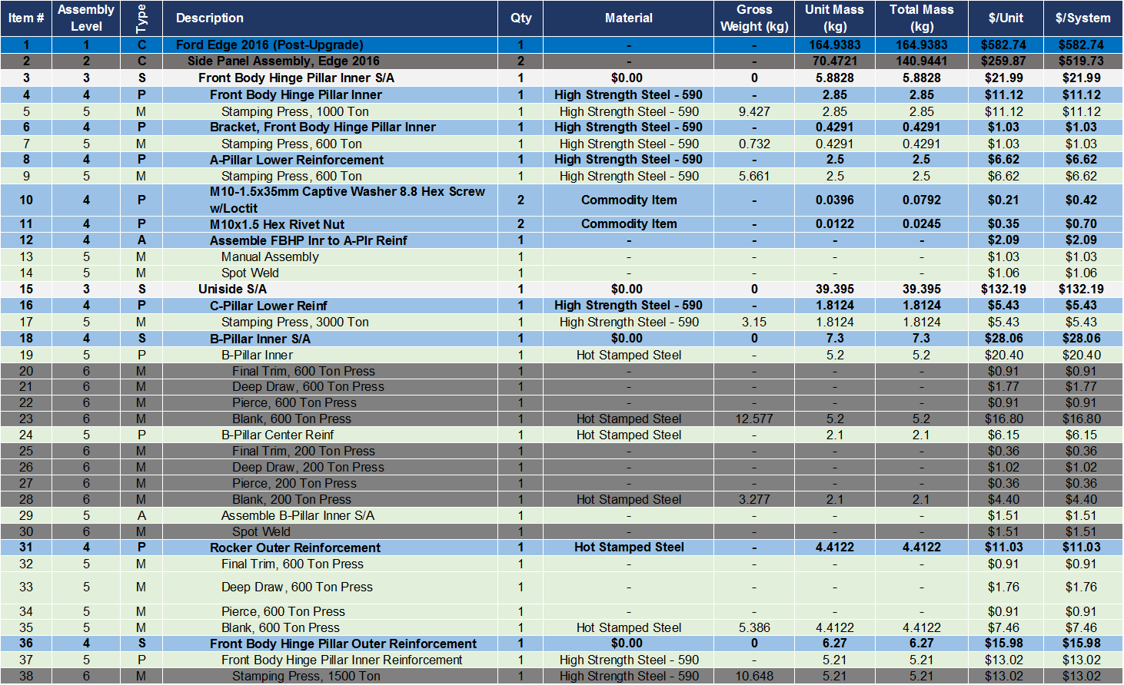
Ford Edge 2016 Total Mass and Cost Details –
Side Panel Assembly (1/3)
Material Details Ford Edge, 2016
Type: S=Subassembly, P=Part, M=Manufacturing Process, A=Assemble, C=Container

Slide 27
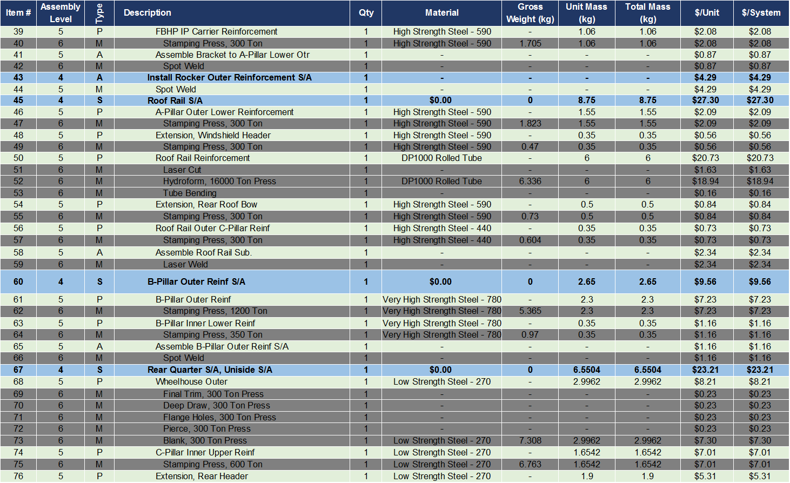
Ford Edge 2016 Total Mass and Cost Details –
Side Panel Assembly (2/3)
Material Details Ford Edge, 2016
Type: S=Subassembly, P=Part, M=Manufacturing Process, A=Assemble, C=Container

Slide 28
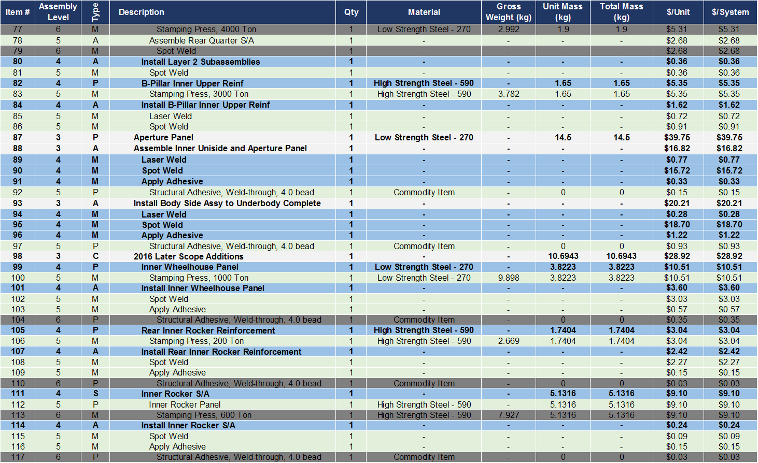
Ford Edge 2016 Total Mass and Cost Details –
Side Panel Assembly (3/3)
Material Details Ford Edge, 2016
Type: S=Subassembly, P=Part, M=Manufacturing Process, A=Assemble, C=Container

Slide 29
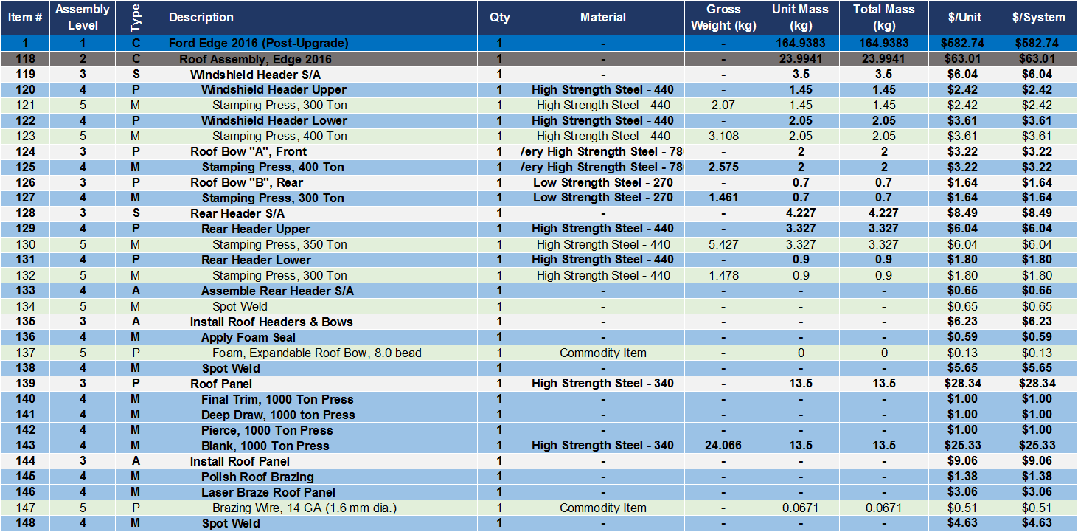
Ford Edge 2016 Total Mass and Cost Details –
Roof Assembly
Material Details Ford Edge, 2016
Type: S=Subassembly, P=Part, M=Manufacturing Process, A=Assemble, C=Container

Slide 30
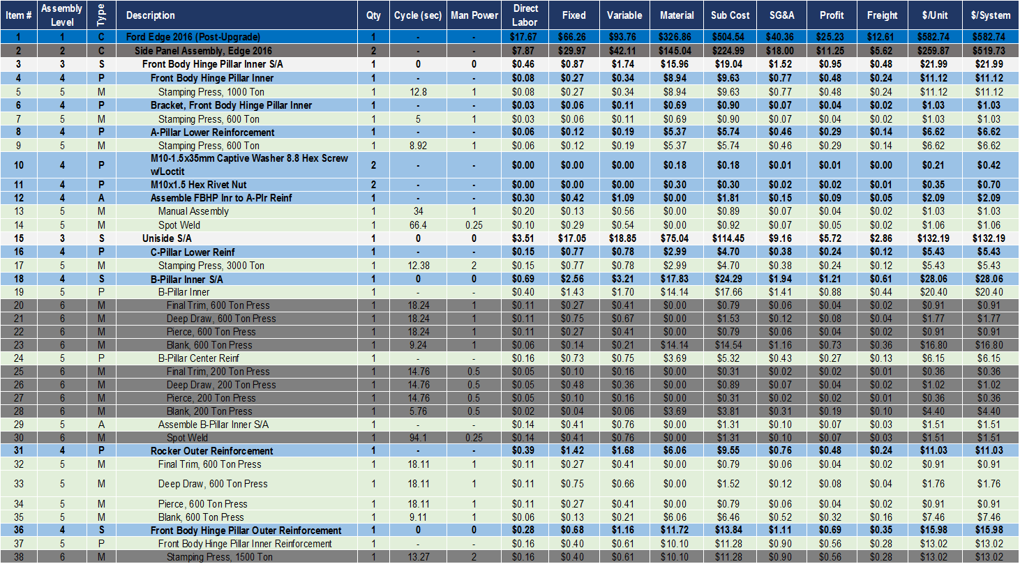
Ford Edge 2016 Manufacturing Cost Details –
Side Panel Assembly (1/3)
Cost Details Ford Edge, 2016
Type: S=Subassembly, P=Part, M=Manufacturing Process, A=Assemble, C=Container

Slide 31
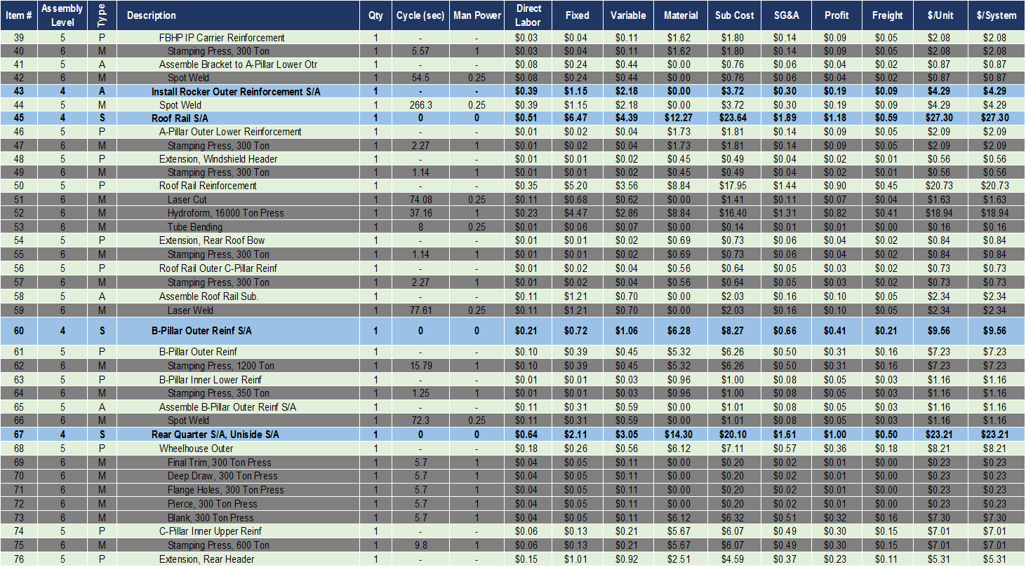
Ford Edge 2016 Manufacturing Cost Details –
Side Panel Assembly (2/3)
Cost Details Ford Edge, 2016
Type: S=Subassembly, P=Part, M=Manufacturing Process, A=Assemble, C=Container

Slide 32
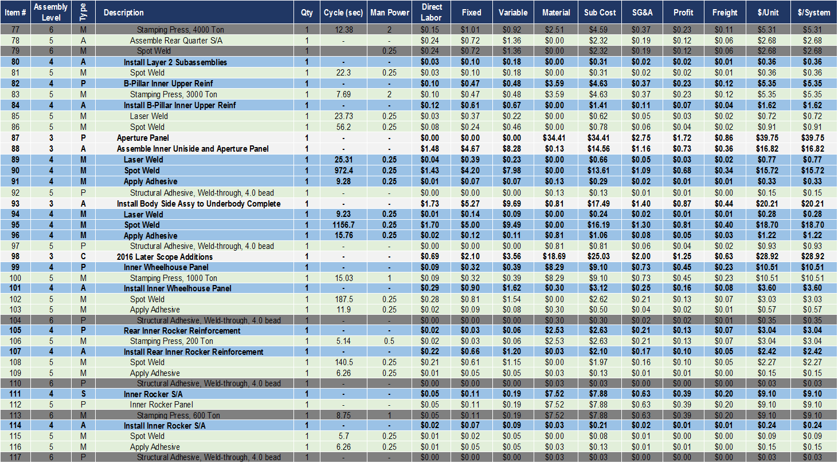
Ford Edge 2016 Manufacturing Cost Details –
Side Panel Assembly (3/3)
Cost Details Ford Edge, 2016
Type: S=Subassembly, P=Part, M=Manufacturing Process, A=Assemble, C=Container

Slide 33
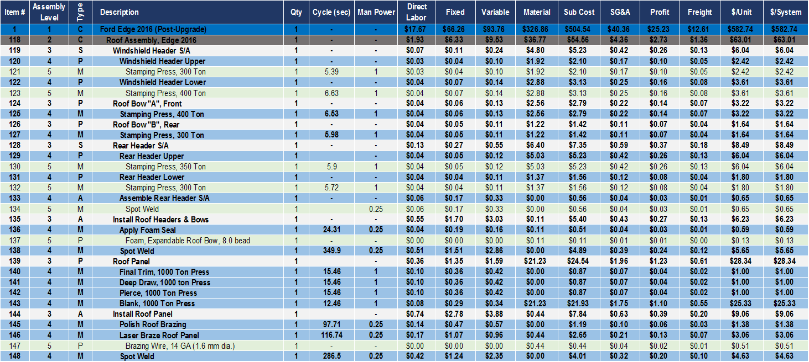
Ford Edge 2016 Manufacturing Cost Details –
Roof Assembly
Cost Details Ford Edge, 2016
Type: S=Subassembly, P=Part, M=Manufacturing Process, A=Assemble, C=Container

Slide 34
Honda Accord, MY 2010
Detail manufacturing costs

Slide 35
Honda Accord 2010 Total Mass and Cost Details –
Side Panel Assembly (1/2)
Material Details Honda Accord, 2010
Type: S=Subassembly, P=Part, M=Manufacturing Process, A=Assemble, C=Container

Slide 36
Honda Accord 2010 Total Mass and Cost Details –
Side Panel Assembly (2/2)
Material Details Honda Accord, 2010
Type: S=Subassembly, P=Part, M=Manufacturing Process, A=Assemble, C=Container

Slide 37
Honda Accord 2010 Total Mass and Cost Details –
Roof Panel Assembly
Material Details Honda Accord, 2010
Type: S=Subassembly, P=Part, M=Manufacturing Process, A=Assemble, C=Container

Slide 38
Honda Accord 2010 Manufacturing Cost Details –
Side Panel Assembly (1/2)
Cost Details Honda Accord, 2010
Type: S=Subassembly, P=Part, M=Manufacturing Process, A=Assemble, C=Container

Slide 39
Honda Accord 2010 Manufacturing Cost Details –
Side Panel Assembly (2/2)
Cost Details Honda Accord, 2010
Type: S=Subassembly, P=Part, M=Manufacturing Process, A=Assemble, C=Container

Slide 40
Honda Accord 2010 Manufacturing Cost Details –
Roof Panel Assembly
Cost Details Honda Accord, 2010
Type: S=Subassembly, P=Part, M=Manufacturing Process, A=Assemble, C=Container

Slide 41
Honda Accord, MY 2014
Detail manufacturing costs

Slide 42
Honda Accord 2014 Total Mass and Cost Details –
Side Panel Assembly (1/2)
Material Details Honda Accord, 2014
Type: S=Subassembly, P=Part, M=Manufacturing Process, A=Assemble, C=Container

Slide 43
Honda Accord 2014 Total Mass and Cost Details –
Side Panel Assembly (2/2)
Material Details Honda Accord, 2014
Type: S=Subassembly, P=Part, M=Manufacturing Process, A=Assemble, C=Container

Slide 44
Honda Accord 2014 Total Mass and Cost Details –
Roof Panel Assembly
Material Details Honda Accord, 2014
Type: S=Subassembly, P=Part, M=Manufacturing Process, A=Assemble, C=Container

Slide 45
Honda Accord 2014 Manufacturing Cost Details –
Side Panel Assembly (1/2)
Cost Details Honda Accord, 2014
Type: S=Subassembly, P=Part, M=Manufacturing Process, A=Assemble, C=Container

Slide 46
Honda Accord 2014 Manufacturing Cost Details –
Side Panel Assembly (2/2)
Cost Details Honda Accord, 2014
Type: S=Subassembly, P=Part, M=Manufacturing Process, A=Assemble, C=Container

Slide 47
Honda Accord 2014 Manufacturing Cost Details –
Roof Panel Assembly
Cost Details Honda Accord, 2014
Type: S=Subassembly, P=Part, M=Manufacturing Process, A=Assemble, C=Container

Slide 48
Ford Mustang, MY 2006
Detail manufacturing costs

Slide 49
Ford Mustang 2006 Total Mass and Cost Details –
Side Panel Assembly
Material Details Ford Mustang, 2006
Type: S=Subassembly, P=Part, M=Manufacturing Process, A=Assemble, C=Container

Slide 50
Ford Mustang 2006 Total Mass and Cost Details –
Roof Panel Assembly
Material Details Ford Mustang, 2006
Type: S=Subassembly, P=Part, M=Manufacturing Process, A=Assemble, C=Container

Slide 51
Ford Mustang 2006 Manufacturing Cost Details –
Side Panel Assembly
Cost Details Ford Mustang, 2006
Type: S=Subassembly, P=Part, M=Manufacturing Process, A=Assemble, C=Container

Slide 52
Ford Mustang 2006 Manufacturing Cost Details –
Roof Panel Assembly
Cost Details Ford Mustang, 2006
Type: S=Subassembly, P=Part, M=Manufacturing Process, A=Assemble, C=Container

Slide 53
Ford Mustang, MY 2016
Detail manufacturing costs

Slide 54
Ford Mustang 2016 Total Mass and Cost Details –
Side Panel Assembly (1/2)
Material Details Ford Mustang, 2016
Type: S=Subassembly, P=Part, M=Manufacturing Process, A=Assemble, C=Container

Slide 55
Ford Mustang 2016 Total Mass and Cost Details –
Side Panel Assembly (2/2)
Material Details Ford Mustang, 2016
Type: S=Subassembly, P=Part, M=Manufacturing Process, A=Assemble, C=Container

Slide 56
Ford Mustang 2016 Total Mass and Cost Details –
Roof Panel Assembly
Material Details Ford Mustang, 2016
Type: S=Subassembly, P=Part, M=Manufacturing Process, A=Assemble, C=Container

Slide 57
Ford Mustang 2016 Manufacturing Cost Details –
Side Panel Assembly (1/2)
Cost Details Ford Mustang, 2016
Type: S=Subassembly, P=Part, M=Manufacturing Process, A=Assemble, C=Container

Slide 58
Ford Mustang 2016 Manufacturing Cost Details –
Side Panel Assembly (2/2)
Cost Details Ford Mustang, 2016
Type: S=Subassembly, P=Part, M=Manufacturing Process, A=Assemble, C=Container

Slide 59
Ford Mustang 2016 Manufacturing Cost Details –
Roof Panel Assembly
Cost Details Ford Mustang, 2016
Type: S=Subassembly, P=Part, M=Manufacturing Process, A=Assemble, C=Container

Slide 60
Grand Cherokee, MY 2008
Detail manufacturing costs

Slide 61
Grand Cherokee 2008 Total Mass and Cost Details –
Side Panel Assembly
Material Details Grand Cherokee, 2008
Type: S=Subassembly, P=Part, M=Manufacturing Process, A=Assemble, C=Container

Slide 62
Grand Cherokee 2008 Total Mass and Cost Details –
Roof Panel Assembly
Material Details Grand Cherokee, 2008
Type: S=Subassembly, P=Part, M=Manufacturing Process, A=Assemble, C=Container

Slide 63
Grand Cherokee 2008 Manufacturing Cost Details –
Side Panel Assembly
Cost Details Grand Cherokee, 2008
Type: S=Subassembly, P=Part, M=Manufacturing Process, A=Assemble, C=Container

Slide 64
Grand Cherokee 2008 Manufacturing Cost Details –
Roof Panel Assembly
Cost Details Grand Cherokee, 2008
Type: S=Subassembly, P=Part, M=Manufacturing Process, A=Assemble, C=Container

Slide 65
Grand Cherokee, MY 2011
Detail manufacturing costs

Slide 66
Grand Cherokee 2011 Total Mass and Cost Details –
Side Panel Assembly (1/2)
Material Details Grand Cherokee, 2011
Type: S=Subassembly, P=Part, M=Manufacturing Process, A=Assemble, C=Container

Slide 67
Grand Cherokee 2011 Total Mass and Cost Details –
Side Panel Assembly (2/2)
Material Details Grand Cherokee, 2011
Type: S=Subassembly, P=Part, M=Manufacturing Process, A=Assemble, C=Container

Slide 68
Grand Cherokee 2011 Total Mass and Cost Details –
Roof Panel Assembly
Material Details Grand Cherokee, 2011
Type: S=Subassembly, P=Part, M=Manufacturing Process, A=Assemble, C=Container

Slide 69
Grand Cherokee 2011 Manufacturing Cost Details –
Side Panel Assembly (1/2)
Cost Details Grand Cherokee, 2011
Type: S=Subassembly, P=Part, M=Manufacturing Process, A=Assemble, C=Container

Slide 70
Grand Cherokee 2011 Manufacturing Cost Details –
Side Panel Assembly (2/2)
Cost Details Grand Cherokee, 2011
Type: S=Subassembly, P=Part, M=Manufacturing Process, A=Assemble, C=Container

Slide 71
Grand Cherokee 2011 Manufacturing Cost Details –
Roof Panel Assembly
Cost Details Grand Cherokee, 2011
Type: S=Subassembly, P=Part, M=Manufacturing Process, A=Assemble, C=Container

Slide 72
Buick LaCrosse, MY 2005
Detail manufacturing costs

Slide 73
Buick LaCrosse 2005 Total Mass and Cost Details –
Side Panel Assembly (1/2)
Material Details Buick LaCrosse, 2005
Type: S=Subassembly, P=Part, M=Manufacturing Process, A=Assemble, C=Container

Slide 74
Buick LaCrosse 2005 Total Mass and Cost Details –
Side Panel Assembly (2/2)
Material Details Buick LaCrosse, 2005
Type: S=Subassembly, P=Part, M=Manufacturing Process, A=Assemble, C=Container

Slide 75
Buick LaCrosse 2005 Total Mass and Cost Details –
Roof Panel Assembly
Material Details Buick LaCrosse, 2005
Type: S=Subassembly, P=Part, M=Manufacturing Process, A=Assemble, C=Container

Slide 76
Buick LaCrosse 2005 Manufacturing Cost Details –
Side Panel Assembly (1/2)
Cost Details Buick LaCrosse, 2005
Type: S=Subassembly, P=Part, M=Manufacturing Process, A=Assemble, C=Container

Slide 77
Buick LaCrosse 2005 Manufacturing Cost Details –
Side Panel Assembly (2/2)
Cost Details Buick LaCrosse, 2005
Type: S=Subassembly, P=Part, M=Manufacturing Process, A=Assemble, C=Container

Slide 78
Buick LaCrosse 2005 Manufacturing Cost Details –
Roof Panel Assembly
Cost Details Buick LaCrosse, 2005
Type: S=Subassembly, P=Part, M=Manufacturing Process, A=Assemble, C=Container

Slide 79
Buick LaCrosse, MY 2010
Detail manufacturing costs

Slide 80
Buick LaCrosse 2010 Total Mass and Cost Details –
Side Panel Assembly (1/3)
Material Details Buick LaCrosse, 2010
Type: S=Subassembly, P=Part, M=Manufacturing Process, A=Assemble, C=Container

Slide 81
Buick LaCrosse 2010 Total Mass and Cost Details –
Side Panel Assembly (2/3)
Material Details Buick LaCrosse, 2010
Type: S=Subassembly, P=Part, M=Manufacturing Process, A=Assemble, C=Container

Slide 82
Buick LaCrosse 2010 Total Mass and Cost Details –
Side Panel Assembly (3/3)
Material Details Buick LaCrosse, 2010
Type: S=Subassembly, P=Part, M=Manufacturing Process, A=Assemble, C=Container

Slide 83
Buick LaCrosse 2010 Total Mass and Cost Details –
Roof Panel Assembly
Material Details Buick LaCrosse, 2010
Type: S=Subassembly, P=Part, M=Manufacturing Process, A=Assemble, C=Container

Slide 84
Buick LaCrosse 2010 Manufacturing Cost Details –
Side Panel Assembly (1/3)
Cost Details Buick LaCrosse, 2010
Type: S=Subassembly, P=Part, M=Manufacturing Process, A=Assemble, C=Container

Slide 85
Buick LaCrosse 2010 Manufacturing Cost Details –
Side Panel Assembly (2/3)
Cost Details Buick LaCrosse, 2010
Type: S=Subassembly, P=Part, M=Manufacturing Process, A=Assemble, C=Container

Slide 86
Buick LaCrosse 2010 Manufacturing Cost Details –
Side Panel Assembly (3/3)
Cost Details Buick LaCrosse, 2010
Type: S=Subassembly, P=Part, M=Manufacturing Process, A=Assemble, C=Container

Slide 87
Buick LaCrosse 2010 Manufacturing Cost Details –
Roof Panel Assembly
Cost Details Buick LaCrosse, 2010
Type: S=Subassembly, P=Part, M=Manufacturing Process, A=Assemble, C=Container

Slide 88
Chevrolet Impala, MY 2003
Detail manufacturing costs

Slide 89
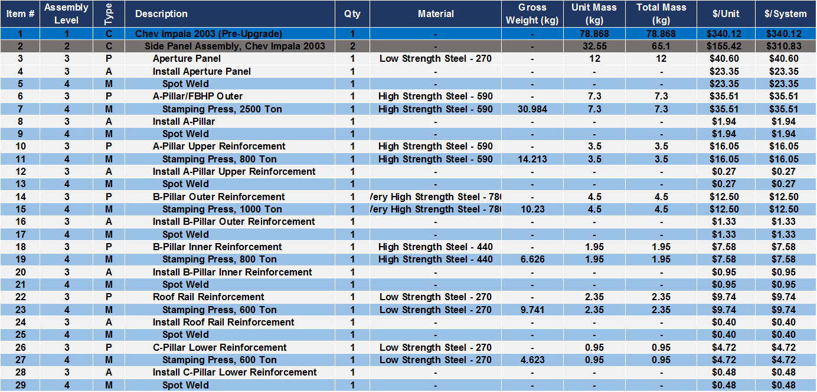
Chevrolet Impala 2003 Total Mass and Cost Details –
Side Panel Assembly
Material Details Chevrolet Impala, 2003
Type: S=Subassembly, P=Part, M=Manufacturing Process, A=Assemble, C=Container

Slide 90
Chevrolet Impala 2003 Total Mass and Cost Details –
Roof Panel Assembly
Material Details Chevrolet Impala, 2003
Type: S=Subassembly, P=Part, M=Manufacturing Process, A=Assemble, C=Container

Slide 91
Chevrolet Impala 2003 Manufacturing Cost Details –
Side Panel Assembly
Cost Details Chevrolet Impala, 2003
Type: S=Subassembly, P=Part, M=Manufacturing Process, A=Assemble, C=Container

Slide 92
Chevrolet Impala 2003 Manufacturing Cost Details –
Roof Panel Assembly
Cost Details Chevrolet Impala, 2003
Type: S=Subassembly, P=Part, M=Manufacturing Process, A=Assemble, C=Container

Slide 93
Chevrolet Impala, MY 2011
Detail manufacturing costs

Slide 94
Chevrolet Impala 2011 Total Mass and Cost Details –
Side Panel Assembly (1/2)
Material Details Chevrolet Impala, 2011
Type: S=Subassembly, P=Part, M=Manufacturing Process, A=Assemble, C=Container

Slide 95
Chevrolet Impala 2011 Total Mass and Cost Details –
Side Panel Assembly (2/2)
Material Details Chevrolet Impala, 2011
Type: S=Subassembly, P=Part, M=Manufacturing Process, A=Assemble, C=Container

Slide 96
Chevrolet Impala 2011 Total Mass and Cost Details –
Roof Panel Assembly
Material Details Chevrolet Impala, 2011
Type: S=Subassembly, P=Part, M=Manufacturing Process, A=Assemble, C=Container

Slide 97
Chevrolet Impala 2011 Manufacturing Cost Details –
Side Panel Assembly (1/2)
Cost Details Chevrolet Impala, 2011
Type: S=Subassembly, P=Part, M=Manufacturing Process, A=Assemble, C=Container

Slide 98
Chevrolet Impala 2011 Manufacturing Cost Details –
Side Panel Assembly (2/2)
Cost Details Chevrolet Impala, 2011
Type: S=Subassembly, P=Part, M=Manufacturing Process, A=Assemble, C=Container

Slide 99
Chevrolet Impala 2011 Manufacturing Cost Details –
Roof Panel Assembly
Cost Details Chevrolet Impala, 2011
Type: S=Subassembly, P=Part, M=Manufacturing Process, A=Assemble, C=Container

